Slide 1
Data Analysis on
FIFA 18

Slide 2
Data Sources
Kaggle datasets

Slide 3
Pre-Processing
Cleaning data
Converting Columns

Slide 4
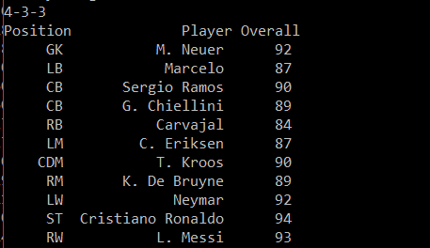
Analysis
Getting the best squad
Pre-Specified formation
Identifying single position from preferred positions
Getting Name of player by using loc on position and overall

Slide 5
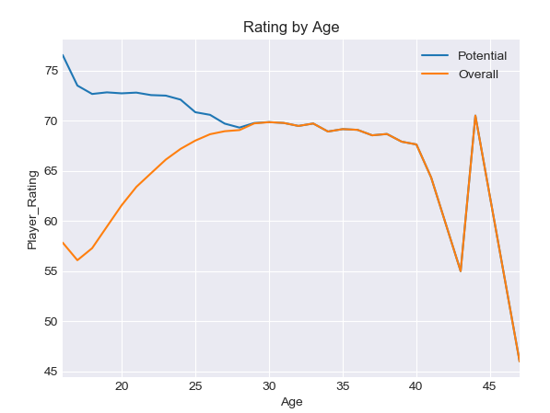
Visualization
Visualizing the peak of player using overall
Grouping the players by age
Getting a visualization by age of player and overall

